Slide 1
Study and Implementation on Facial Key Points Detection
Presented by
Md. Ikramul Murad
Registration no: 15602000014
Session: 2015-16

Slide 2
Facial Key Points Detection
Facial key points detection is a computer technology that is being applied for many different applications that require the identification of human faces in digital images or video.
Detecting facial key points is a very challenging problem.
Due to 3D pose, size, position, viewing angle, and illumination conditions.

Slide 3
Objective
Tracking faces in images and video
Analyzing facial expressions
Detecting dysmorphic facial signs for medical diagnosis
Biometrics / face recognition

Slide 4
Existing Key Points Detection Algorithms
Algorithms that decides whether an image is a positive image also called face image or negative image also called non-face image, also known as classifier.
To classify a new image correctly, it is trained on hundreds of thousands of face and non-face images.
This feature answers the explicit question “Where are the faces in this picture?”.

Slide 5
OpneCV
OpenCV is a popular computer vision library started in 1999.
It comes with a programming interface to C, C++, Python and Android.
It explicitly defines facial key-points configuration using following algorithms:
Eigenfaces
Fisherfaces
Local Binary Patterns Histograms

Slide 6
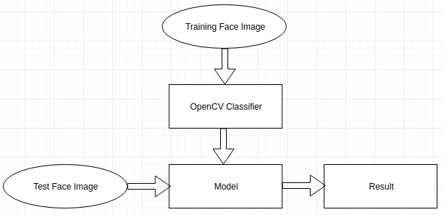
OpenCV Workflow
Fig: OpenCV workflow

Slide 7
Advantages
Computationally simple and fast
Shorter training time
Better performance in offline learning system

Slide 8
Disadvantages
Not a knowledge based system
Cannot be used in online learning system
Difficult to evolve

Slide 9
Machine Learning
Machine learning is an application of artificial intelligence (AI) that provides systems the ability to automatically learn and improve from experience without being explicitly programmed. Machine learning focuses on the development of computer programs that can access data and use it learn for themselves.

Slide 10
Deep Learning
Deep learning is a subset of machine learning in Artificial Intelligence (AI) that has networks capable of learning unsupervised from data that is unstructured or unlabeled. Also known as Deep Neural Learning or Deep Neural Network.

Slide 11
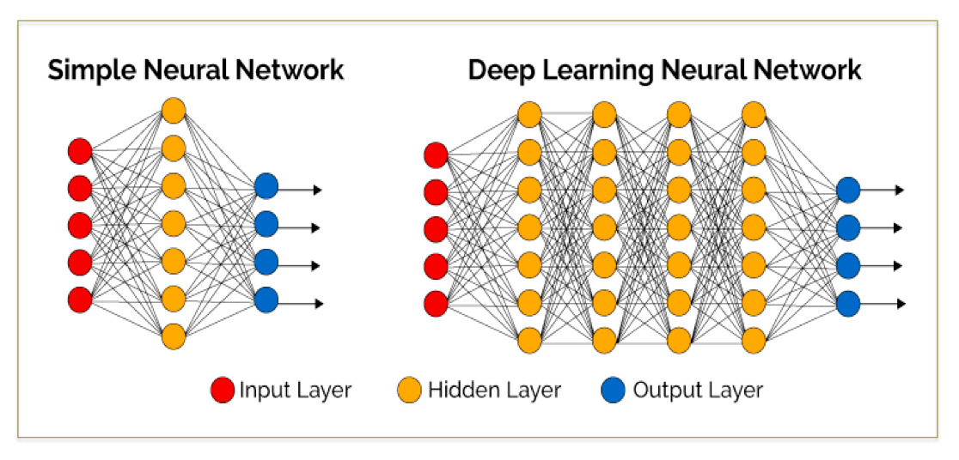
Fig: Neural network and deep neural network

Slide 12
Convolutional Neural Network
A convolutional neural network (CNN) is a type of artificial neural network used in image recognition and processing that is specifically designed to process pixel data.
CNNs are powerful image processing, artificial intelligence (AI) that use deep learning to perform both generative and descriptive tasks, often using computer vision that includes image and video recognition.

Slide 13
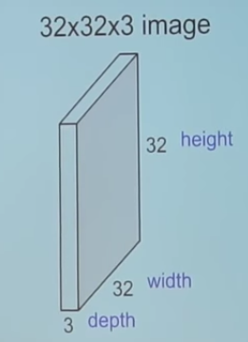
Fig: Example image

Slide 14
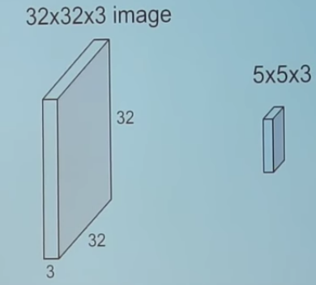
Fig: Using filter in image

Slide 15
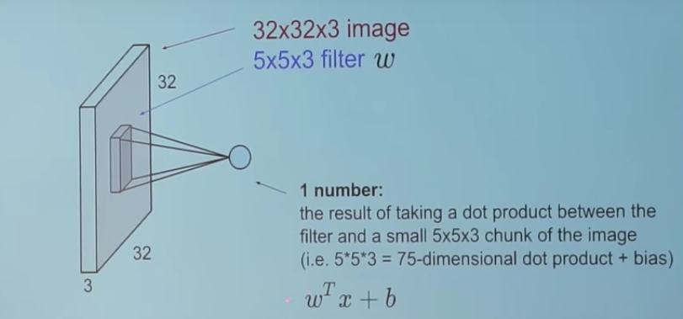
Fig: Traverse filter over image

Slide 16
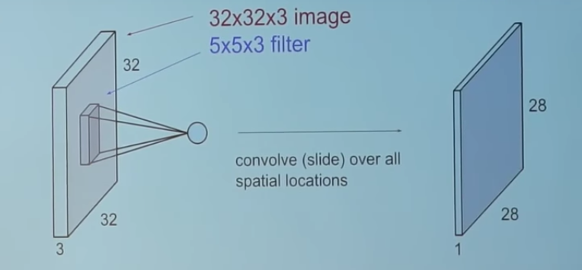
Fig: New filtered input entry

Slide 17
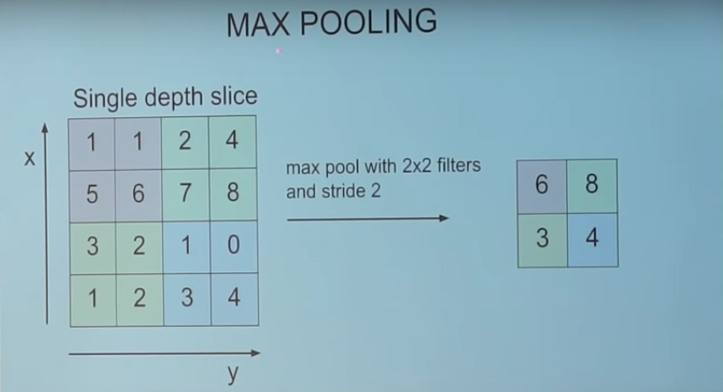
Fig: Max Pooling

Slide 18
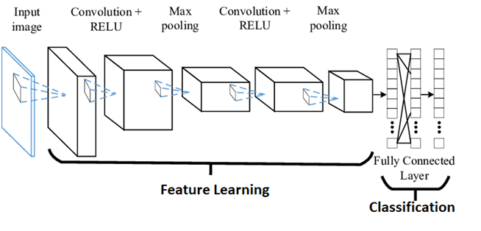
Fig: Feature extraction

Slide 19
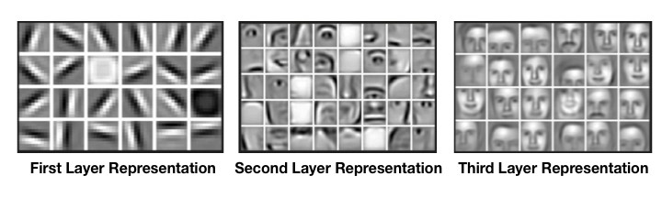
Fig: Layer representation

Slide 20
Proposed ML based Facial Key Points Detection System
In this proposed system, the combined knowledge of computer vision techniques and deep learning architectures will be applied to build a facial key points detection system.
Facial key points include points around the eyes, nose, and mouth on a face and are used in many applications.
The final system should be able to look at any image, detect faces, and predict the locations of facial key points on each face.
This system has several applications including facial tracking, facial pose recognition, facial filters, and emotion recognition.

Slide 21
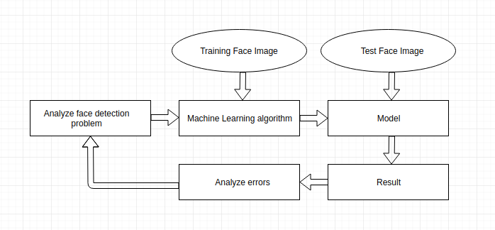
Workflow Diagram of the Proposed System
Fig: Proposed Machine Learning based system

Slide 22
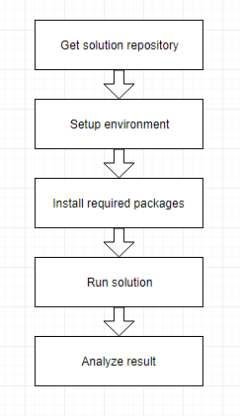
User Perspective Workflow
Fig: User perspective workflow

Slide 23
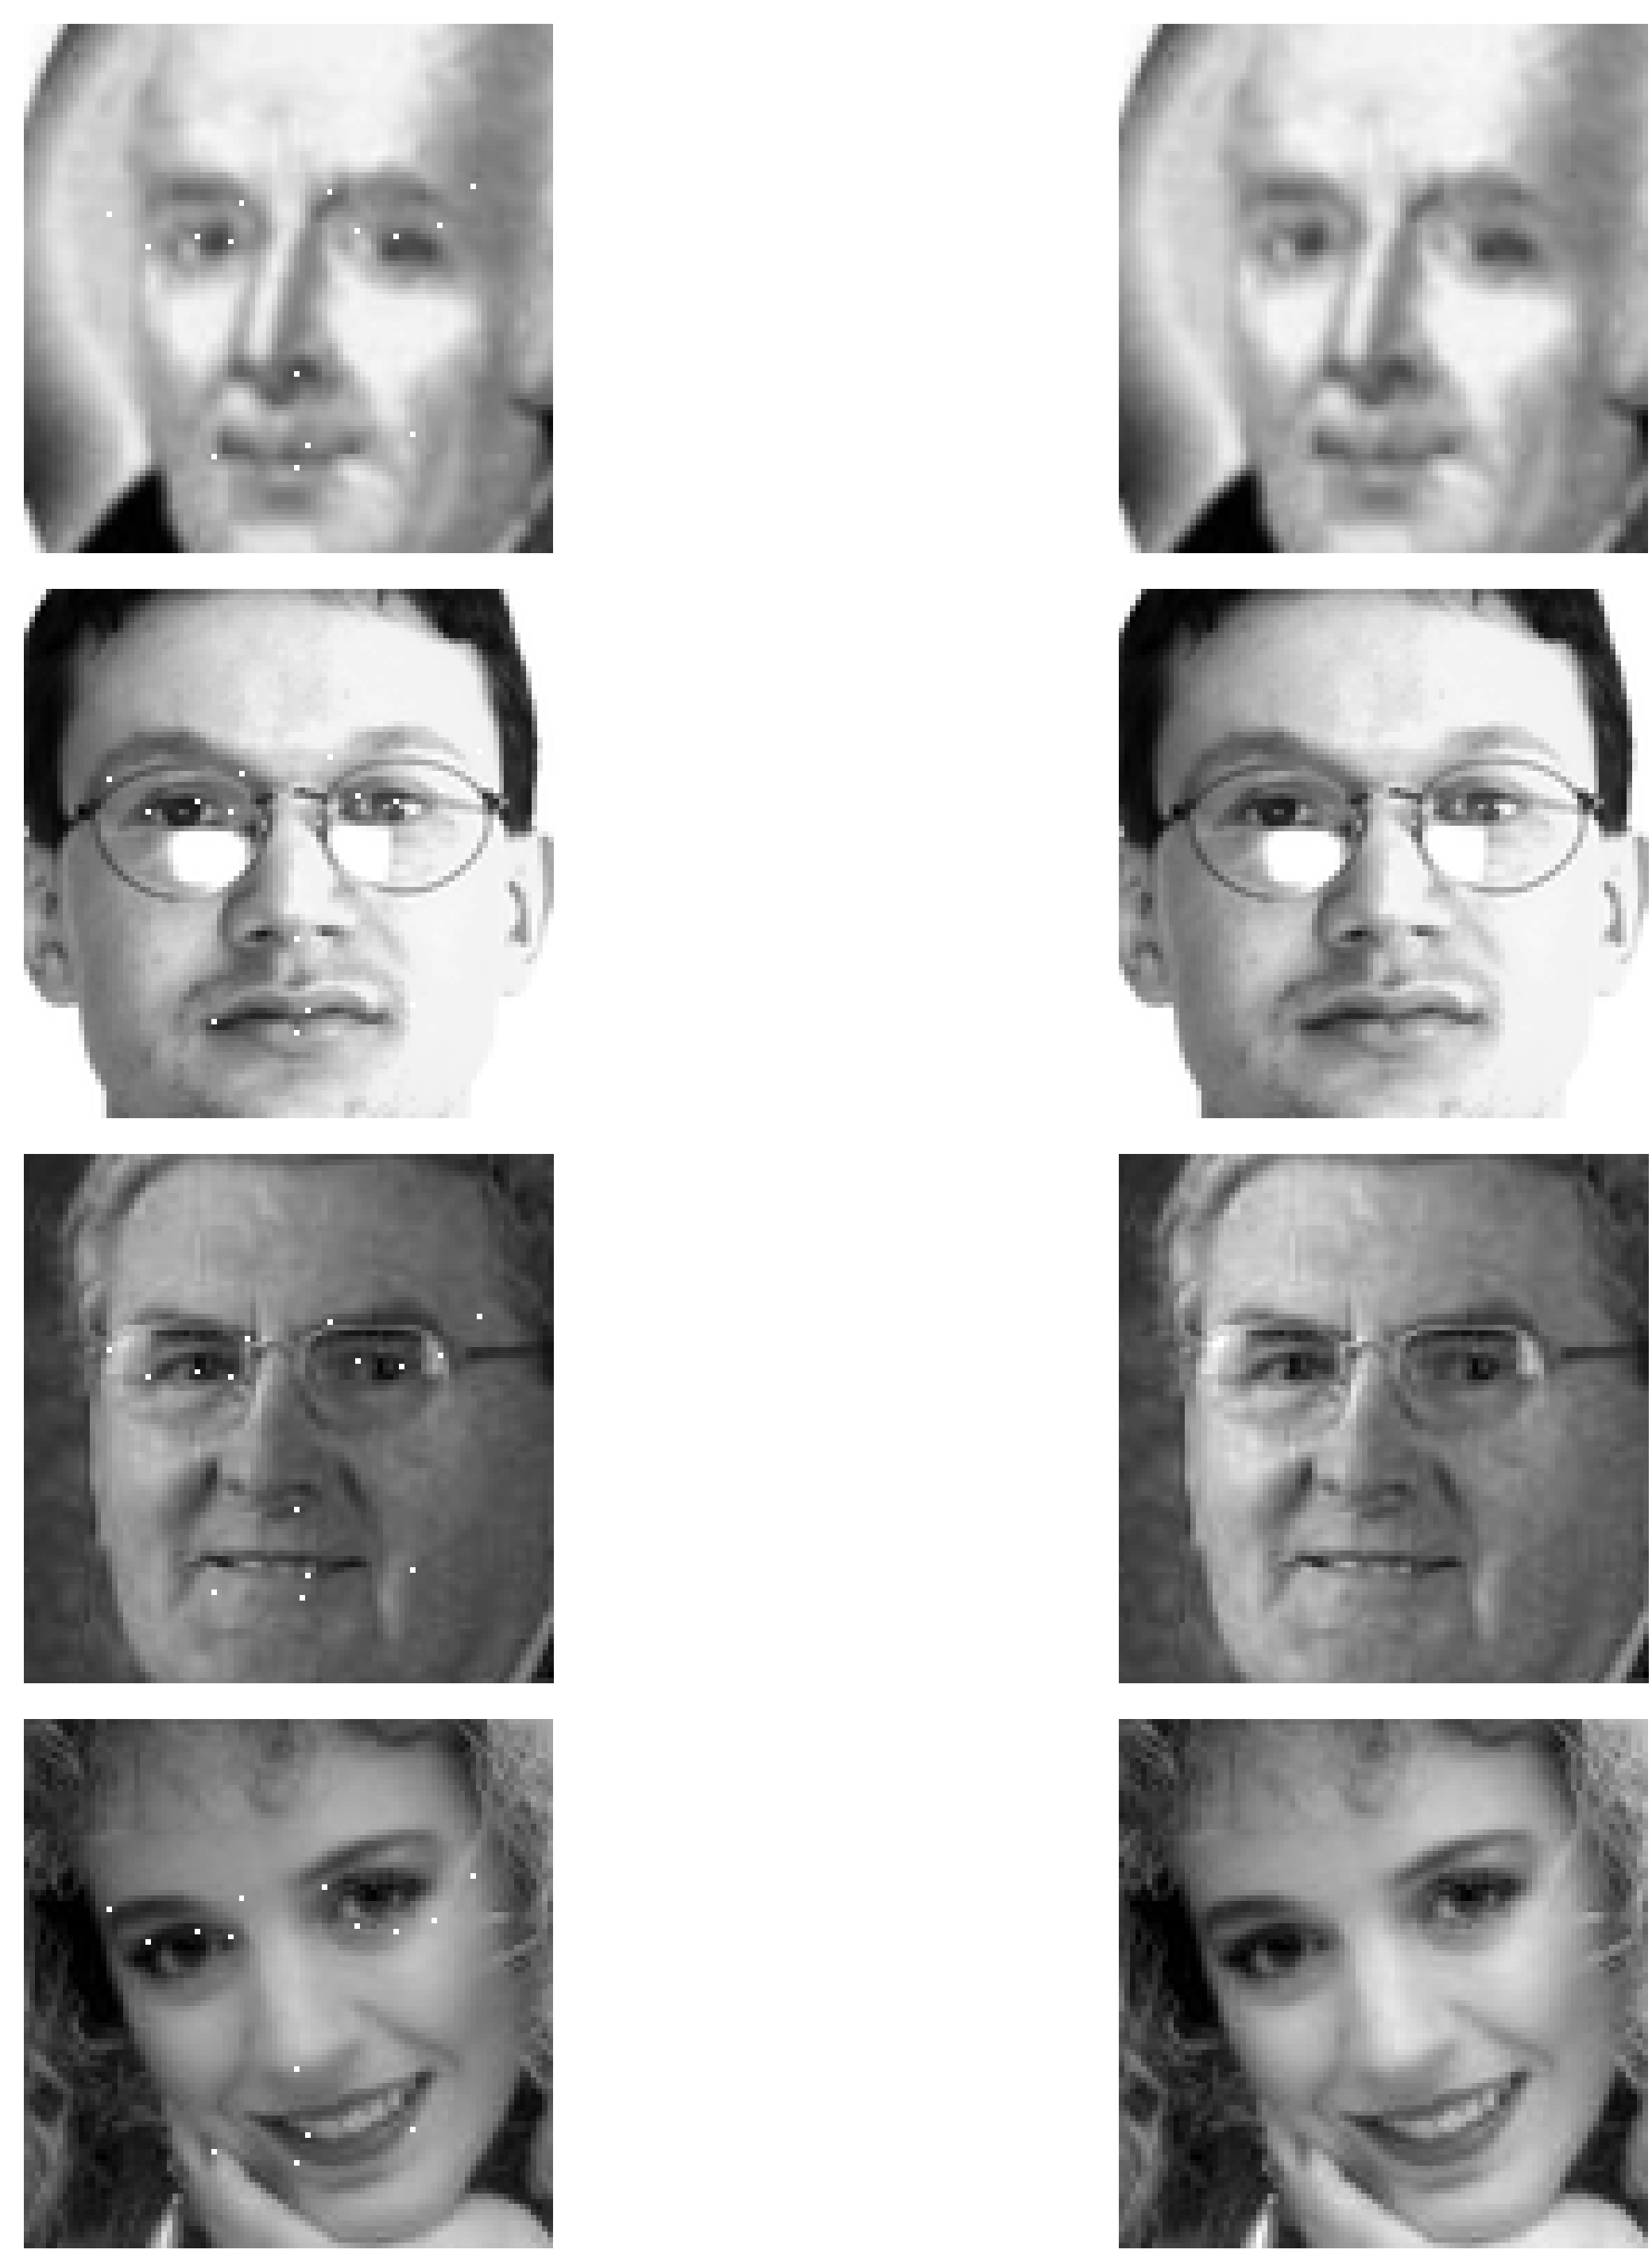
Fig: Result image

Slide 24
Features
Can be used in online learning system
Easy to integrate
It is possible to automate the learning system

Slide 25
Merits of the System
Detect facial key points with high accuracy
Easy to use in time series problem
Low false positive rate

Slide 26
Required Hardware Tools
CPU: Core i7 at least 3.0 GHz and quad core
RAM: 16 GB
GPU: Nvidia graphics at least 3 GB
Auxiliary Storage: 512 GB SSD with 1 TB HDD

Slide 27
Required Software Tools
Python 3.5
IDE
Numpy
Matplotlib
Pandas
Seaborn
Tensorflow
Keras

Slide 28
Thank you

